Slide 1

Lesson One Energy Basics
The Harnessed Atom

Slide 2
What you need to know about Energy:
States of energy
Potential
Kinetic
Forms of energy
Energy sources
Primary and secondary sources
Renewable and nonrenewable
Conversion
Conservation
Environmental impacts
Greenhouse effect
Future sources

Slide 3

What is ENERGY?
Energy is “the ability to do work.”
You might think of work as…
cleaning your room
cutting the grass
studying for a test
To a scientist, “work” means something exact: Work is causing a change, like
change in position (moving clothes from the floor to the laundry basket)
a change in temperature (heating water for a cup of tea)
a change in form (the water in your tea changing to steam).
What have you done today that required energy?
What sources of energy have you harnessed?
Notes:
Ask students what they have done that didn’t use energy.
We use energy all the time. Ask students to identify ways that energy is used in your classroom.
Some children may not understand the word ‘harness.’ When something weak uses something strong, we call that harnessing. You can harness a horse if you fasten a yoke to it so that the horse’s energy will move you or a vehicle. Today, we control other energy sources to direct work we want done.

Slide 4

What are the states of energy?
There are two basic states of energy:
Potential energy
is stored and waits for you to use it.
Kinetic energy
is energy in motion.
Notes:
Show the class a rubber band. Pull on it and ask: is this potential or kinetic energy? What kind of energy is it if I release it?
Wind up a yo-yo. Ask the same questions.

Slide 5
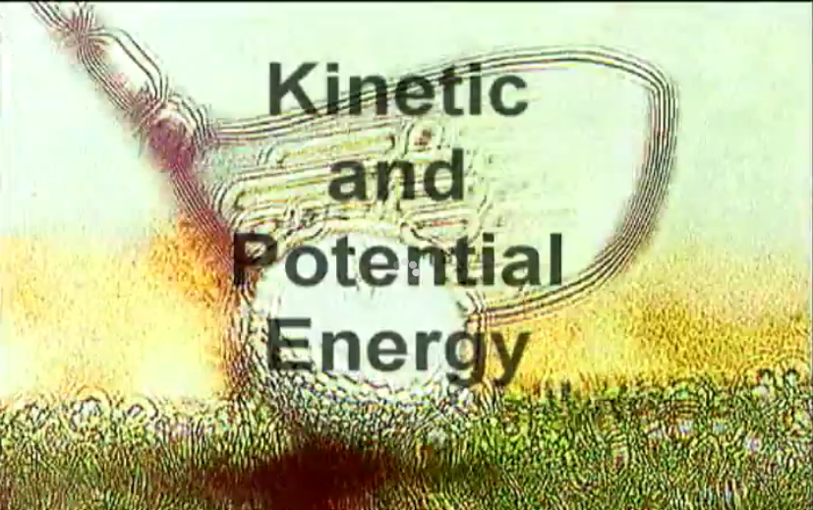
This tune is sure to get stuck in your head!
This tune and animation will help you remember the two energy states:
Potential and Kinetic.
http://www.youtube.com/watch?v=vl4g7T5gw1M
Notes:
The clip above is about 2 minutes. Highlight the url and choose “Open Hyperlink.” Olé!
Credit: "Kinetic and Potential Energy" by Tom Glazer and Dottie Evans from the Singing Science Records

Slide 6

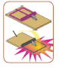


What are the forms of energy?
Mechanical energy is the energy that moves objects by applying a force.
Chemical energy is the energy released when the chemical bonds of a material change.
Electrical energy is the flow of tiny charged particles called electrons. Electrons move through a conductor, like copper wire.
Radiant energy is energy traveling in waves.
Notes:
Ask students to match the examples at the bottom of the slides to the definitions above. Burning wood is chemical energy. The mousetrap is mechanical energy. The Sun is radiant energy. And the plug is electrical energy.
Ask them to think of other examples of these forms. What are their potential and kinetic states?

Slide 7



More forms of energy
Nuclear energy is energy stored in the center (nucleus) of an atom. That energy binds the center together and is released when atoms split apart.
Thermal energy is heat energy.
Energy from gravity is the energy of position or place.
Notes:
As you did with slide 4, ask students to match the illustrations with the forms of energy definitions.
Ask them to think of other examples of these forms. What are their potential and kinetic states?

Slide 8

Where does energy come from?
Much of the energy we use comes from the Sun.
Plants convert the Sun’s radiant energy into chemical energy (wood or sugars, for example).
Wood can be burned for thermal energy (to boil water) or radiant energy (to heat your home.)
Biomass is the name for plant and animal materials that have chemical energy from the Sun stored in them.
Notes:
Ask students: Is the wind is related to the Sun? (Answer: the Sun warms some areas of the Earth more than others. Air surrounding these warmer surfaces is heated, which causes it to rise. Cooler air from the less heated surfaces then flows in to replace the heated air that has risen. Wind results.)
Ask students: What form of energy turns wind mills? (Answer: The kinetic energy of the wind moves the mechanical energy of the wind mill.) What about water mills? (Energy from the flow of water moved acted on by gravity moves the mechanical mill.)

Slide 9
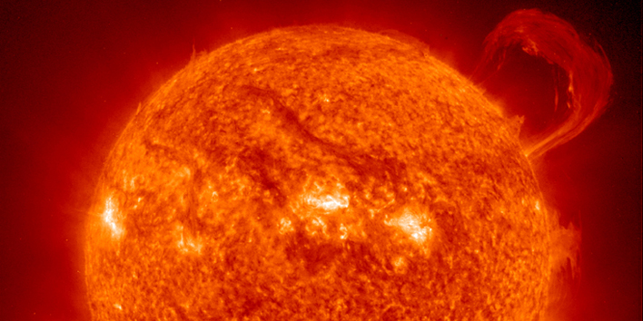
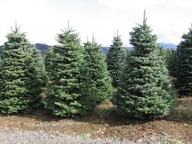
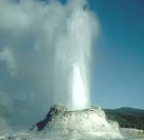
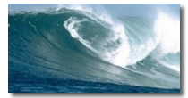
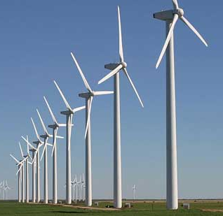
What are the primary energy sources?
solar energy ……sunlight
biomass …..plants
water power…. flowing water
fossil fuel energy ……coal, natural gas, oil
nuclear energy…..uranium, plutonium, hydrogen
geothermal energy……heat from inside the Earth
tidal energy ……gravity of the Moon and Sun affects the oceans
wind energy …. moving air caused by the sun heating the atmosphere
Notes:
Ask students: how does tidal energy work? (Twice a day every day the tides rise and fall in ways that can be predicted. The rush of water of the tide can turn turbines placed in the water.)
Why don’t we use this energy source more? (A tidal range of at least 7 is best to provide energy. There are not many sites on Earth where the difference between the high tides and low tides is great enough to use tidal energy to generate electricity.)

Slide 10
Why aren’t wood or wind or switch grass on the list of primary sources?
Because they are secondary sources. Secondary sources are produced by a primary source.
Primary source Secondary source(s)
Sun
wood; food; water; wind; electricity
Fossil Fuels
electricity
Geothermal
electricity
Notes:
Ask students to name a fossil fuel their families use as a primary source everyday (gasoline in their cars; diesel fuel in buses; natural gas to heat their homes or to cook food).
What secondary sources do they use? (electricity; food)
Remind students that fossil fuels were formed millions of years ago from plant and animal material that stored the Sun’s energy, so we now list them as primary energy sources.
Make sure students don’t confuse natural gas and gasoline. Both are often referred to as “gas.”

Slide 11
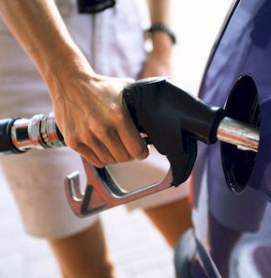
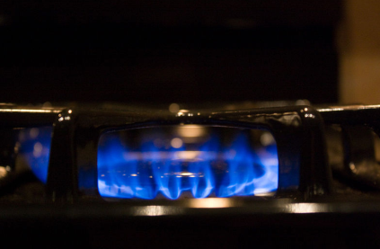
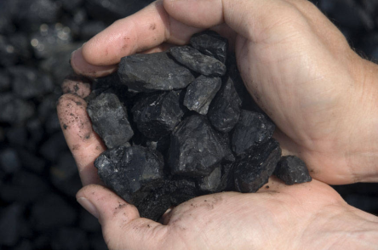
Will we ever run out of some energy sources?
Yes. Sources that are non-renewable are limited.
Non-renewable energy sources include fossil fuels, like
Coal
Petroleum (Oil)
Natural Gas
Uranium is non-renewable, but can be recycled.
In the United States, most of the energy we use now comes from fossil fuels.

Slide 12
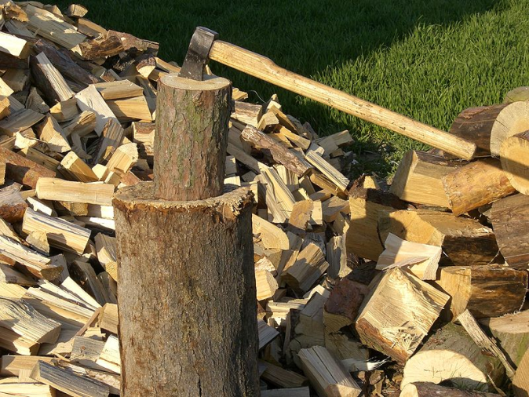
What are renewables?
Renewable energy sources are continuously replaced. They include
Biomass
Hydroelectric
Wind
Geothermal
Solar
Wood is biomass, a renewable source of energy.
Notes:
Biomass, as a renewable energy source, is biological material from living, or recently living organisms. Biomass can either be used directly or converted into other fuels such as ethanol or methane. Biomass can be grown from many types of fast-growing plants, including switchgrass, hemp, corn, even sugarcane. It can also use wood waste from making paper and lumber.

Slide 13
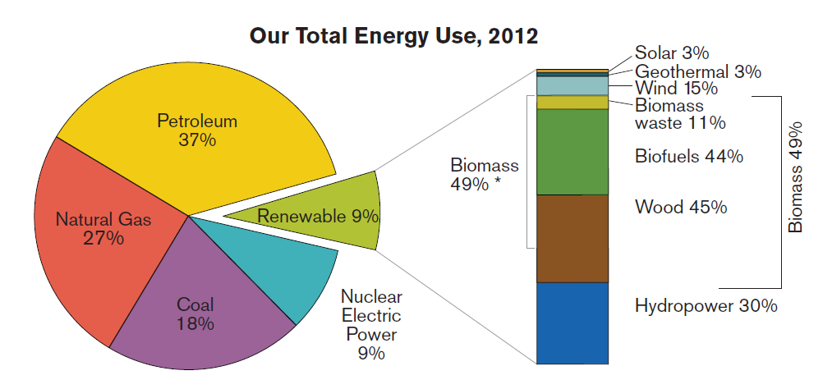
Sources of energy in the United States
Notes:
Ask students to identify the non-renewables (petroleum, natural gas, coal, nuclear). Ask: What is the non-renewable energy source that we use the most? (petroleum) Ask: How do we use petroleum? (to run automotives, primarily) How do we use coal? nuclear? (to generate electricity, primarily). How do we use natural gas? (to heat buildings, in industrial heating, and to generate electricity). We’ll talk about electricity more in the next lesson.
The renewables are listed in order of the most to the least used.
Source: U.S. Energy Information Administration, Monthly Energy Review, Table 10.1 (2012), preliminary 2010 data. You can update the information in the pie chart by checking the Department of Energy’s Energy Information Administration website: http://www.eia.gov

Slide 14
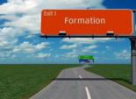
Where do fossil fuels come from?
Fossil fuels formed about 300 million years ago in the late Paleozoic Era from the remains of plants and animals under heat and pressure beneath layers of Earth.
We consider fossil fuels to be primary energy sources even though they originally took their energy from the Sun and stored it as chemical energy.
Video clip: How biomass created fossil fuels http://www.teachertube.com/viewVideo.php?video_id=200563
(courtesy of Ohio's Natural Gas & Crude Oil Producers)
Notes:
Ask students to name the fossil fuels (oil, coal, and natural gas).
The clip above runs about 2 minutes. Highlight the url with your cursor. Right click from your mouse to select “Open Hyperlink.”

Slide 15
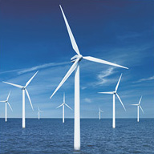
Renewable sources have limits, too.
Renewable means new energy keeps being made. The Sun rises every day. The wind blows. Rivers flow.
Having an energy supply we can use now and also count on into the future is important.
But there are limits to renewable energy:
Sources are not constant. (The Sun goes down, wind dies down, and rivers have dry seasons.)
Harnessing them can be expensive.
The best locations for capturing renewable energy are often far from where people live, so getting the energy to people is difficult.
Notes:
Tell students that scientists today are working on finding ways to use renewable energy. This photo is taken off the coast of Virginia. Scientists at the Virginia Coastal Energy Research Consortium are also working on using tidal and wave energy to create electricity and marine algae for creating fuel.

Slide 16
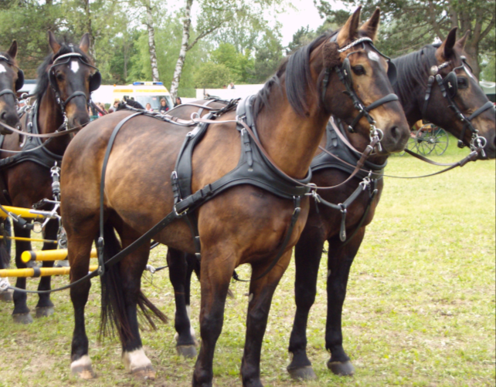
Law of Conservation of Energy
The Law of Conservation of Energy says that energy can change from one form into another, but it cannot be created or destroyed.
When we use energy, we harness it to do the work we need to do.
harness
Notes:
Some students may not understand the word ‘harness.’ When something weak uses something strong, we call that harnessing. You can harness a horse if you fasten gear to it so that the horse’s energy will move you or a vehicle. Today we control other energy sources to direct work we want done.

Slide 17
We mean energy conversion.
When we use energy, we really mean we
convert it to do the work we need.
Every minute, energy is converted in many ways.
For example, a soccer player is converts energy in his lunch into energy to play the game.
His muscles convert the stored chemical energy in the hamburger he ate into mechanical energy to run down the field.
The chemical energy t is also converted to thermal energy. As he plays, his body gives off a lot of heat!
Notes:
A car is an energy converter. Ask students: How do cars convert gasoline in the work we need? Answer: Car engines ignite and burn gasoline to produce mechanical energy to move the gears and wheels of a car. When the engine moves the wheels, the mechanical energy becomes kinetic energy moving the car and its occupants along.

Slide 18
Conversion can waste a lot of energy.
When a conversion process wastes a lot of energy, we call it inefficient. Most energy conversion processes are inefficient. As a result, energy is lost to the environment.
Diagram of the efficiency in a gas-powered car:
http://www.fueleconomy.gov/feg/atv.shtml
Notes:
Ask the class how the soccer player wasted energy. Answer: Sweat! He used only about 1/4th of the burger to play soccer. The rest of the burger’s energy was lost to heat production.
Ask students to think about a car ride. Gasoline moves the car. What else is produced? Answer: Heat. Think of how hot the hood of a car is after a trip. In fact, gas-powered cars waste about 85% of the energy in fuel. The above link takes you to a diagram that shows typical energy uses and losses in a vehicle. (Highlight the url in the slide above and choose “Open Hyperlink.”) Ask students to draw a pie chart of the energy efficiency of a car using the percentages in the diagram. The pie piece used to actually move the car and run accessories will be slim!

Slide 19

How can we save energy?
We can save energy through conservation.
Conserving energy extends the length of time non-renewable energy sources are available.
How can you conserve energy?
Reduce
Drive less (walk, bike, carpool, take the bus)
Turn off things that use electricity when you don’t need them
Reuse
Give away your too small soccer shoes to another player
Recycle
Gather paper, glass, plastic and metal to recycle
Notes:
Ask the class if they have any family rules or habits that conserve energy? Do they leave their computers on all the time? Do they have a neighborhood recycling program? Does your school?

Slide 20
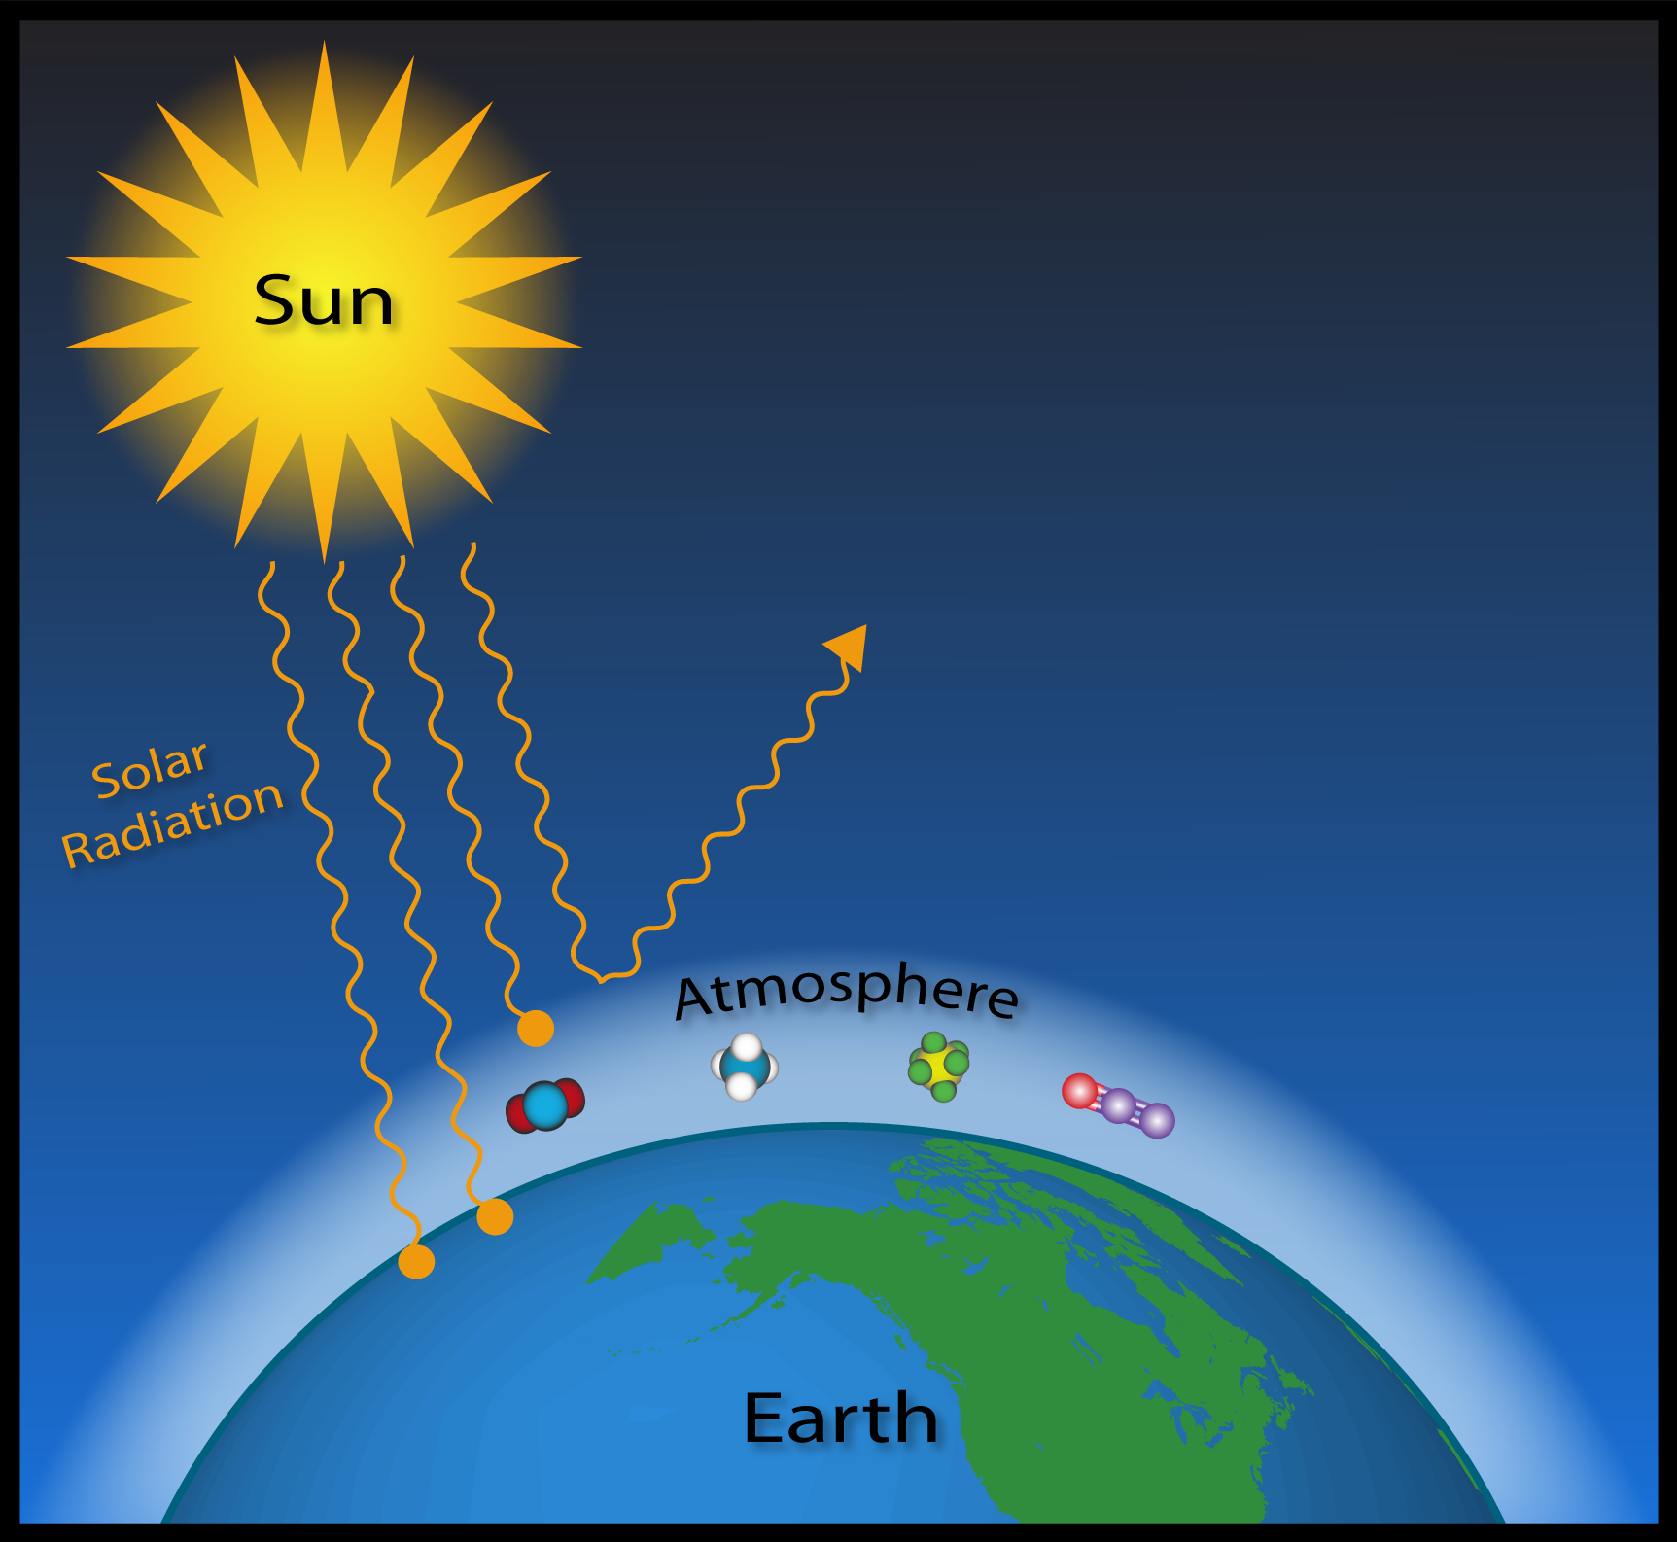
Greenhouse gases trap heat.
Gases surround our planet. When sunlight warms the Earth, these gases trap some of the Sun’s heat.
Certain gases like carbon dioxide are called greenhouse gases because they act like a greenhouse to trap more heat in the atmosphere and affect the climate.
Changing temperatures can produce more storms, floods, droughts, melting polar ice, and rising sea levels.
Notes:
Teacher resources on the Greenhouse Effect are available from the National Oceanic and Atmospheric Administration (NOAA) .
http://www.esrl.noaa.gov/gmd/outreach/carbon_toolkit/basics.html
Composition of Earth's Dry Atmosphere (as of 2009)
Nitrogen 78.1%
Oxygen 20.9%
Argon .9%
Carbon Dioxide .039%
Methane .00018%
Nitrous Oxide .000032%
Sulfur Hexafluoride .00000000067%

Slide 21
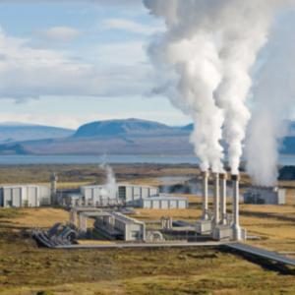
Where do greenhouse gases come from?
Greenhouse gases occur both naturally and from human activity. Some activities are related to energy uses.
What are the most common greenhouse gases?
Carbon dioxide (CO₂)— comes from burning fossil fuels and exhaling humans.
Methane (CH₄)— comes from landfills, burning oil and natural gas, and agriculture.
Nitrous oxide (N₂O)— comes from fertilizers, burning fossil fuels, and waste.
Water vapor — comes from natural sources and is the most abundant.
Notes:
In 2009, a presidential memo directed the Department of Transportation to raise fuel efficiency standards to 35 miles (56 kilometers) per gallon by 2020. Another directed the Environmental Protection Agency to allow individual states to set stricter car tailpipe emissions.
Ask your students why U.S. energy policy changes matter.

Slide 22
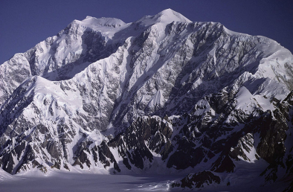
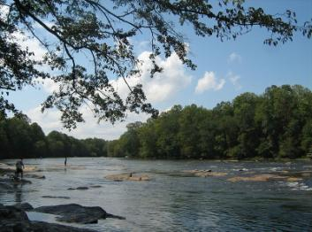

Which energy sources will you use when you grow up?
We will need to make some changes in our future energy sources and in how we use energy.
We’ll have to think about
How available is each source, and where is it located?
What is the cost of that source?
What is the impact on the environment from using the energy resource?
What is right for a location?
Notes:
The United States buys almost half of our oil from foreign countries. For our national security, many people want us to be able to produce the energy we need from U.S. sources. Ask: What are those sources? Who should pay for the research?
Why is it difficult to use more renewable energy sources like wind and solar? Answer: The most significant problem with using renewable energy sources is that most of them produce electricity intermittently. Unlike nuclear and fossil fuel plants, which can provide a predictable and scalable base load of electricity to meet demand, intermittent sources may produce too little electricity at times and too much at others. Although technologies to transfer or store surplus electricity are improving, there is no efficient way to do so on a large scale at this time.
The illustrations above are meant to help students think about natural energy sources in different U.S. regions.

Slide 23
Summary: Fill in the blanks
Energy is the ability to do work .
There are two basic states of energy – potential energy and kinetic energy. Potential energy is stored energy. Kinetic energy is energy in motion.
There are many forms of potential and kinetic energy, including mechanical, chemical, thermal, electrical, radiant, nuclear, and the energy of gravity.
The five primary sources we use today are fossil fuel energy, nuclear energy, geothermal energy, solar energy, and tidall energy. All these can be used to make electricity, a secondary source of energy.
Energy sources can be divided into renewable and nonrenewable sources.
Notes:
The answers are in the sentences above. You can turn this page into an activity using your cursor to highlight the blank spaces. Use your toolbar to make the font not white.
Review these facts with students before or after a quiz.

Slide 24
Summary (continued)
Non-renewable sources cannot be replaced. Renewable sources can be replaced.
We can convert energy from one form to another, but we cannot create or destroy energy.
Saving energy is called conservation. Although conservation is not an energy source, we can use it to extend the time non-renewable sources will be available.
There are environmental impacts from use of all energy sources. Name 3.
climate change wastes water contamination cutting forests
Meeting energy needs during your lifetime may be different than in the past.
Notes:
The answers are in the sentences above. You can turn this page into an activity using your cursor to highlight the blank spaces. Use your toolbar to make the answers’ font not white.
You may want to copy and paste this summary into a Word file to use as a quick quiz.

Slide 25
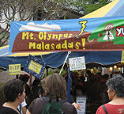
Advanced Student Assignment
Design an imaginary city.
Give your city a name, a location, and a primary energy source.
Answer these questions:
Why is that source perfect for your location?
What cost savings does it offer newcomers?
What impact on the environment does it have?
Create a bill board for visitors to read. Tell them what they need to know about your city’s energy source.
Notes:
This could be a homework assignment. Students could draw their billboards as posters.
The photos are meant to encourage students to think about the natural resources of their locations and use them in designing their cities’ energy supplies.

Slide 26
Vocabulary
biodiesel – a type of fuel made by processing vegetable oils and other fats; used either in pure form or as an additive to petroleum-based diesel fuel
biofuel – a type of fuel made from plant material or animal waste; examples include bioethanol, alcohol, or biodiesel; used mostly for transportation
biomass – plant material and animal waste used as fuel
carbon dioxide (CO₂) – a greenhouse gas emitted from fossil fuel power plants and from burning biomass
chemical energy – the energy released when the chemical makeup of atoms and molecules of a material changes
climate – the average weather (temperature, precipitation, wind, etc.) for a particular region and time of year, usually figured for decades

Slide 27
Vocabulary
climate change – any significant change in measures of climate (temperature, precipitation, wind) that lasts for decades or more
conservation – saving or preserving something
efficient – producing a desired effect, especially in producing the effect without waste
electrical energy – the flow of tiny, negatively charged particles called electrons, usually through a wire
energy – the ability to do work
energy from gravity – the energy of position or place
ethanol – an alcohol fuel made mainly from grain, such as corn
exports – products we make and sell to other countries
Notes:
The answers are in the sentences above. You can turn this page into an activity using your cursor to highlight the blank spaces. Use your toolbar to make the answers’ font not white.

Slide 28
Vocabulary
fossil fuel – a natural fuel formed in the geological past from the remains of living organisms; examples are coal, oil, or natural gas
geothermal energy – energy from using the heat of the Earth’s interior
global warming - an average increase in the temperature of the Earth’s atmosphere and gradual changes in global climate patterns; higher average temperatures do not necessarily mean there will be warmer weather at any particular place on Earth
greenhouse effect – the situation whereby the Earth's atmosphere traps heat because of the presence in the atmosphere of gases that allow incoming sunlight to pass through but absorb heat radiated back from the Earth's surface
greenhouse gas – any gas that absorbs infrared radiation in the atmosphere and traps heat in the atmosphere. Greenhouse gases include water vapor, carbon dioxide (CO2), methane (CH4), and nitrous oxide (N2O).

Slide 29
Vocabulary
hydropower – electric power made by water falling at a dam or moving water in a river or the ocean
inefficient – wasteful of time or energy
imports – products we buy from other countries
intermittent – not continuous; stopping and starting at intervals
kinetic energy – energy in action
mechanical energy – the energy that moves objects by applying a force
methane (CH₄) – a greenhouse gas that comes from landfills, coal mines, oil and natural gas operations, and from agriculture
nitrous oxide (N₂O) – a greenhouse gas that comes from the use of nitrogen fertilizers and from burning fossil fuels

Slide 30
Vocabulary
non-renewable energy - energy sources that cannot be replenished (made again) in a short period of time
nuclear energy – the energy stored in the nucleus of an atom; can be released when the center splits apart during fission or when centers join together during fusion
photosynthesis – the process in which plants convert the Sun’s energy to chemical energy stored as sugars or starches.
potential energy – stored energy; the capability to produce energy; for example, coal has potential energy: when it is burned, it gives off heat and light
radiant energy – energy traveling as waves
renewable energy - an energy resource that is replaced rapidly by natural processes; examples include solar, wind, hydropower, geothermal, and biomass

Slide 31
Vocabulary
secondary energy sources – an energy source we get from the conversion of primary energy sources (coal, oil, nuclear, solar energy); the energy sources we use to make electricity can be renewable or non-renewable, but electricity itself is neither renewable nor nonrenewable
solar energy – energy from the Sun
thermal energy – heat energy
tidal energy – a type of hydropower resulting from the rise and fall of the oceans’ tides
uranium – a heavy, hard, shiny metal that is radioactive; used as the fuel for nuclear power plants; symbol is U
water vapor – a greenhouse gas

Slide 32
Vocabulary
weather – a short-term state of the atmosphere; measured in temperature, precipitation, wind speed, storms, etc.
wind energy – energy from the flow of air
work – causing change (position, temperature, form, etc.)

Slide 33
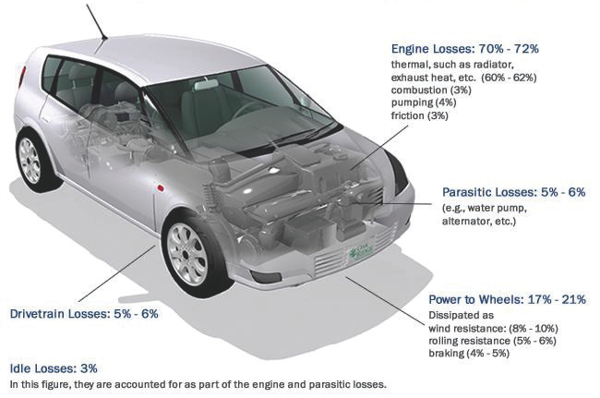
For discussion: What is the best way to get there?
Notes:
When we go somewhere in a car, we are using a machine to convert stored chemical energy in gasoline to mechanical energy (kinetic energy of motion). The Second Law of Thermodynamics tells us that every time energy is converted from one form to another, we lose some as wasted energy. In other words, there is less energy available to do useful work.
The typical gasoline-powered automobile engine has a thermal efficiency around 15%. Ask Students: How is an automobile inefficient? The fuel we buy is not all used to move the vehicle. Use the diagram to help students identify areas where energy is converted inefficiently. Lesson 1 has an Activity, Energy Efficiency and the Horseless Carriage that can be done individually or in groups of students as homework or as an in-class assignment.

Slide 34
Human survival is linked to our ability to harness energy
World Population
<1 million
World Population
<1 million
Humans control fire
31,000 BCE
30,000 BCE
27,000 BCE

Slide 35
World Population
<1 million
World Population
<1 million
25,000 BCE
22,000 BCE
20,000 BCE

Slide 36
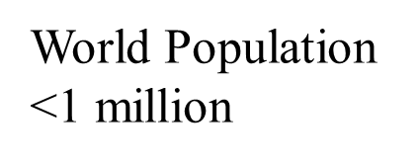
World Population
<1 million
19,000 BCE
16,000 BCE

Slide 37
Humans harness energy from burning wood, grass, dung
World Population
<1 million
15,000 BCE
14,000 BCE
13,000 BCE

Slide 38

World Population
5.3 million
World Population
<1 million
12,000 BCE
10,000 BCE
8,000 BCE

Slide 39
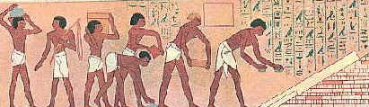
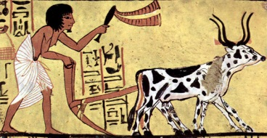
And muscle power of their subjects
Farmers harness animal muscle power
World Population
7 million
World Population
15 million
7,000 BCE
6,000 BCE
5,000 BCE

Slide 40
Geothermal energy harnessed for bathing, cooking, and heating
World Population
35 million
World Population
20 million
4,000 BCE
3,000 BCE
2,000 BCE

Slide 41
World Population
50 million
Hydro power harnessed to mill grain in Asia
World Population
200 million
1,000 BCE
0 BCE

Slide 42
Romans harness coal for heating
World Population
300 million
World Population
400 million
0 CE
1,000 CE

Slide 43
World Population
300 million
World Population
500 million
1000 CE
1400 CE
1600 CE

Slide 44
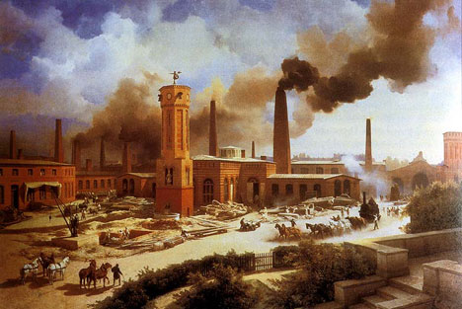

Population
1.6 billion
Industrial Revolution harnesses hydro, wind, wood, coal and muscle energy to increase productivity 50-fold
World Population
500 million
Population
1 billion
1700 CE
1830
1900 CE

Slide 45

Today
7 billion
In scale, this dot would be above the roof ↑
1990
1970
1950
1930 Population
2 billion
1930
1900 CE

